Slide 1

Session 3
Selenium WebDriver –
Getting Started

Slide 2
Knowledge Check
Session 2
What are different Locator Strategies?
What is XPath?
Types of XPath?
How to select unknown nodes?
What are the different relationship of XPath node?
Ways to reach to parent of an XPath element?

Slide 3
Topics
Covered
Java WebDriver Project Setup
Setting up Mozilla Firefox
Setting up Google Chrome
Setting up Internet Explorer
Setting up Microsoft Edge
Debugging using Eclipse

Slide 4
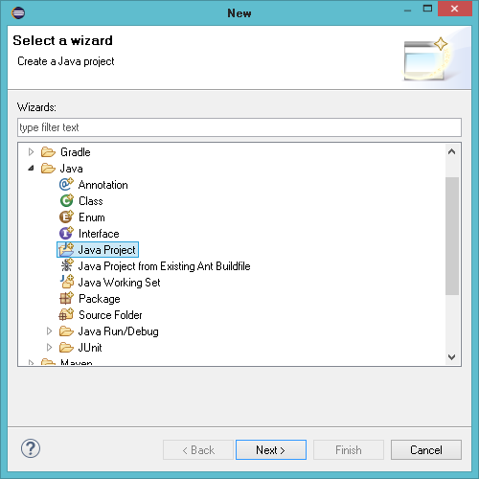
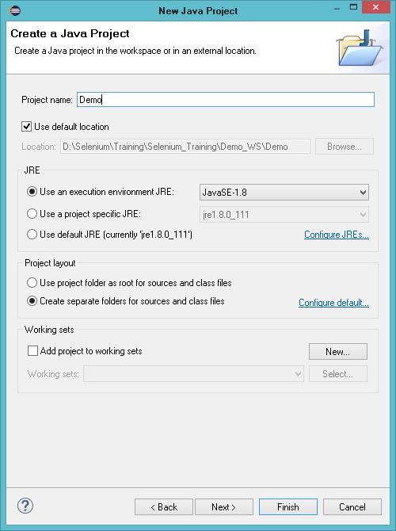
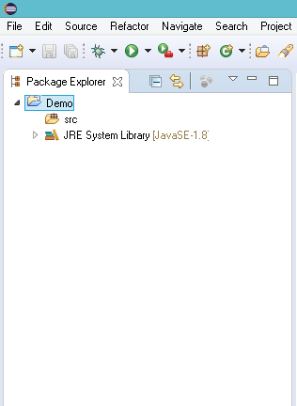
Java WebDriver
Project Setup
Let’s setup a simple Java project in Eclipse and start working with the Selenium WebDriver:
  Open Eclipse and create a new project.

Slide 5
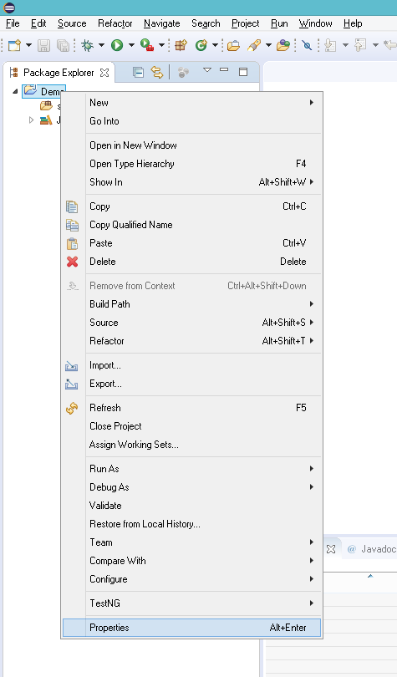
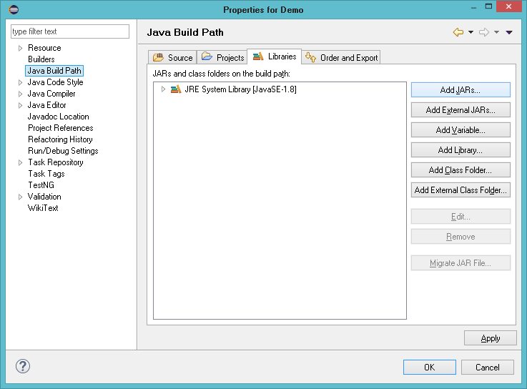
Java WebDriver
Project Setup
  Add Selenium Server Standalone jar into the project.

Slide 6
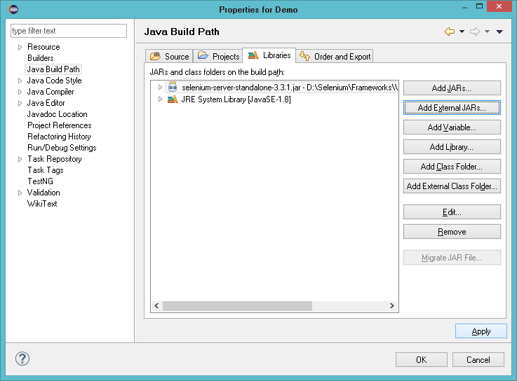
Java WebDriver
Project Setup
  Click Apply and OK to finish the setup.

Slide 7
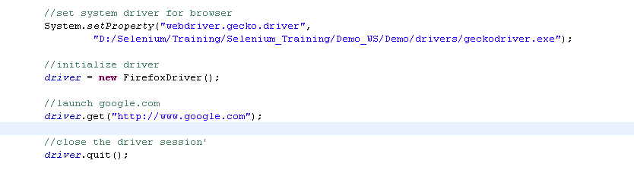
Setting up
Mozilla Firefox

Slide 8
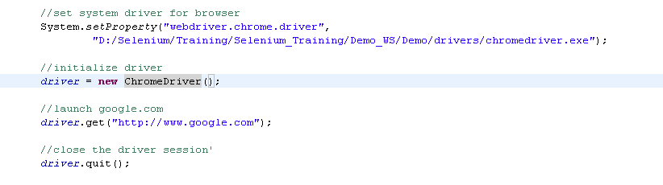
Setting up
Google Chrome

Slide 9
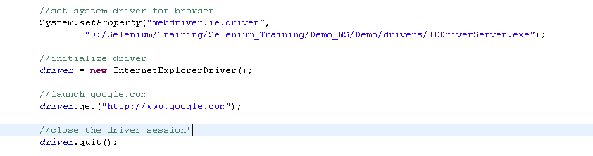
Setting up
Internet Explorer

Slide 10
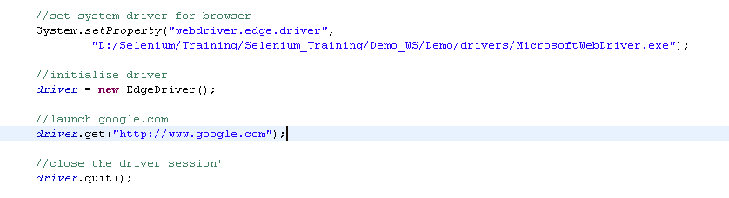
Setting up
Microsoft Edge

Slide 11

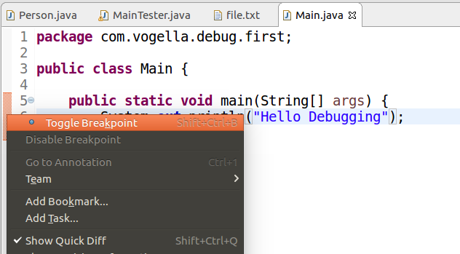
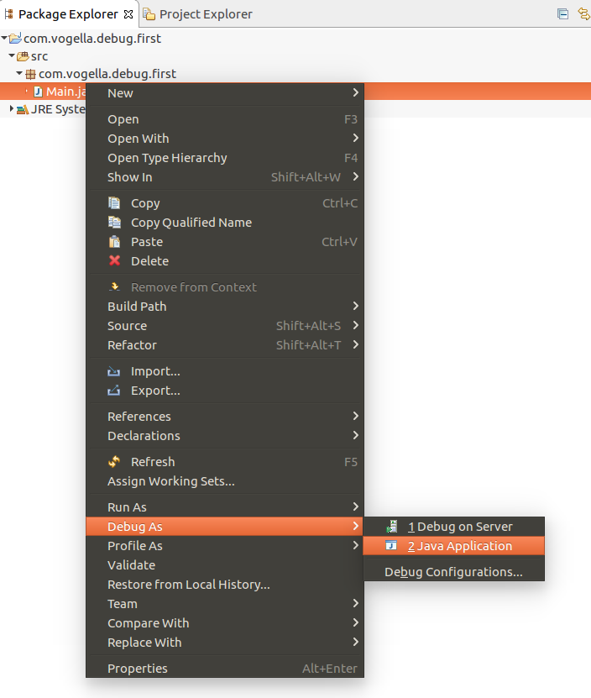

Debugging using
Eclipse
1
2
3

Slide 12


Slide 13
Knowledge Check
Different between Selenium V2 & V3.
What are the general steps to launch a browser in Selenium WebDriver?
Brief Debugging in Eclipse.

